Slide 1

Project Seminar on Web Scraper
Presented By
Mr. Yash Kashti
Guided By
Mrs. Roshani Talmale
Department of Computer Science & Engineering
S. B. JAIN INSTITUTE OF TECHNOLOGY MANAGEMENT AND RESEARCH,NAGPUR
An Autonomous Institute, Affiliated to RTMNU, Nagpur

Slide 2
Contents
Problem Statement & Objectives
Introduction
Literature Survey
System Design
Technology to be Used
Modules / Screenshots
Advantages & Applications
References
2
S. B. Jain Institute of Technology Management and Research

Slide 3
Problem Statement & Objectives
Problem Statement:
As there is a lot of data on Internet which may be useless if you won’t get the desired and relative data from it. Here web scraper plays an important role in gathering data from the Internet, which you think is useful for yourself and rest unstructured / unnecessary data can be avoided . Data which is obtained can be made structured and ordered as your requirement for various purposes.
Here I have developed a web-scraper which provides us the various courses offered by Nagpur university in the field of Science and Technology . The structured data obtained will be saved in CSV file.
3
S. B. Jain Institute of Technology Management and Research

Slide 4

Objectives:
1.To get data in Structured manner
2.To reduce efforts of user
3. To do predictive analysis
4. How data can be extracted from web pages

Slide 5
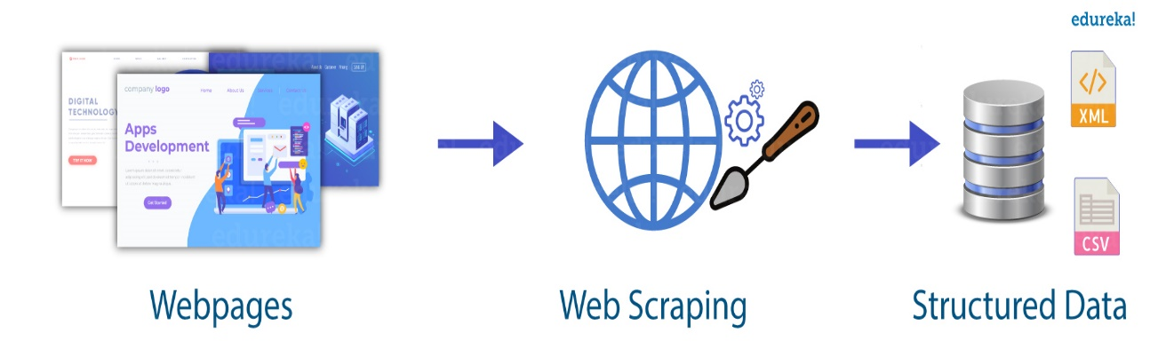
Introduction
What is web scraping?
Web scraping is the process of collecting structured web data in an automated fashion. It’s also called web data extraction. Some of the main use cases of web scraping include price monitoring, price intelligence, news monitoring, lead generation, and market research among many others.
In general, web data extraction is used by people and businesses who want to make use of the vast amount of publicly available web data to make smarter decisions. If you’ve ever copy and pasted information from a website, you’ve performed the same function as any web scraper, only on a microscopic, manual scale.
S. B. Jain Institute of Technology Management and Research
5

Slide 6
Literature Survey
Websites / Paper / Article | Reviews / Findings
https://realpython.com/beautiful-soup-web-scraper-python/ | This website provides an overview of what is web scraper and its uses.
https://www.geeksforgeeks.org/what-is-web-scraping-and-how-to-use-it/ | This web site provides various use cases and its advantages of web scraper.
https://likegeeks.com/python-web-scraping/ | This web-site guides us through various tutorials on web scraper.

Slide 7
System Design: Flowchart
Identify the target website
Collect URLs of the pages where you want to extract data from
Make a request to these URLs to get the HTML of the page
Use locators to find the data in the HTML
Save the data in a JSON or CSV file or some other structured format
S. B. Jain Institute of Technology Management and research
7

Slide 8
Technology to be Use
Technology :
Python
IDE :
PyCharm / VS-Code
Library :
Requests , Beautiful Soup(BS4) ,Pandas
S. B. Jain Institute of Technology Management and research
8

Slide 9

Modules and Screenshots
Gathering RAW Data :
Web Scrapers can extract all the data on particular sites or the specific data that a user wants. Ideally, it’s best if you specify the data you want so that the web scraper only extracts that data quickly.
S. B. Jain Institute of Technology Management and Research
9

Slide 10
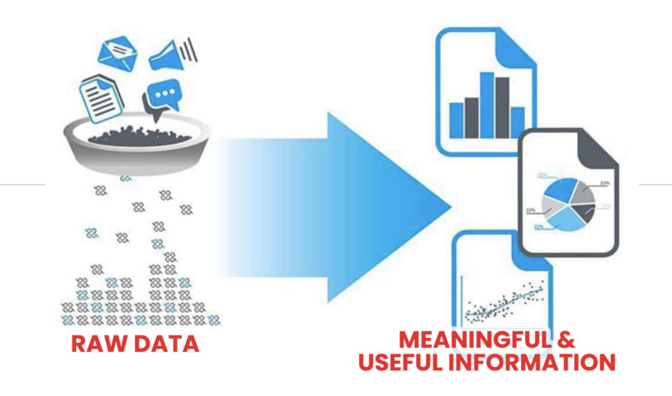
2. Creating Structured Data from the Raw Data :
As the web scraper collects all data from the site ,it is unordered and unstructured , therefore it is necessary to get useful data from the Raw data and make it structured one .
S. B. Jain Institute of Technology Management and Research
10

Slide 11
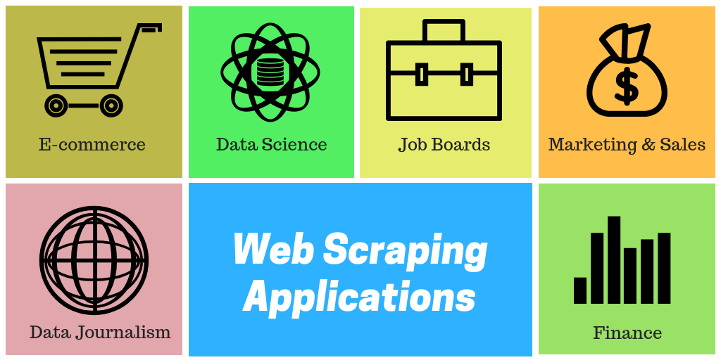
Advantages & Applications
Online price comparison
Contact scraping
Weather data monitoring
Website change detection
Research
Web mash up
Web data integration
Telephone no collection
Address collection
Country/City/State Name Collection.
S. B. Jain Institute of Technology Management and Research
11

Slide 12
References
Papers:
Web Scraping Scientific Repositories for Augmented Relevant Literature Search Using CRISP (https://www.academia.edu/45523560/Web_Scraping_Scientific_Repositories_for_Augmented_Relevant_Literature_Search_Using_CRISP_DM)
Websites:
https://likegeeks.com/python-web-scraping/
https://www.geeksforgeeks.org/what-is-web-scraping-and-how-to-use-it
https://realpython.com/beautiful-soup-web-scraper-python/
S. B. Jain Institute of Technology Management and Research
12

Slide 13
Thank You

